Slide 1
QUICKFIX PRO – HOUSE HOLD SERVICES
GUIDE: ARCHANA MURALI
SMT.PRINCY SUGATHAN s ROLL NO: 11

Slide 2
INTRODUCTION
Service Diversity : platform offering user-friendly access to a diverse range of cleaning, maintenance, and repair services.
Efficiency Through Technology: efficient service delivery, allowing users to schedule and manage tasks seamlessly, while service providers can optimize their workflows for timely and reliable assistance.
Customer-Centric Approach : transparency, reliability, and quality in every service offered, fostering trust and long-term relationships with both service seekers and providers.

Slide 3
LITERATURE REVIEW
SL NO | PAPER TITLE | AUTHORS | YEAR OF PUBLISHING | ADVANTAGE | LIMITATIONS
1 | An Android Application for Home Services”, International Research Journal of Engineering and Technology | Hegde sharaj Bhaskar | published may 2020 | The system comprises an Administrator with site management privileges, a Service Supplier requiring customer registration and login for service requests, followed by a payment process, and customers | A lot more functionalities can be added to this framework, for example, incorporation of various dialects so that it very well may be made accessible to every one of the local individuals who are not adequately taught.

Slide 4
LITERATURE REVIEW
SL NO | PAPER TITLE | AUTHORS | YEAR OF PUBLISHING | ADVANTAGE | LIMITATIONS
2 | Survey on Home Service Provider | Nikam Poonam R, Gunjal Trupti T, Jadhav Priti V, Parakhe Sonali K, Ms. Prachi S. Tambe. | 12dec2019 | The system enforces account creation rules, sends a confirmation message upon registration, allows users to schedule services, and offers a return policy or reservice option in case of user dissatisfaction post-service completion | The conversation installment techniques our framework has, for instance presently framework has online installment by just MasterCard clients further it very well may be reached out by adding the installment administrations for visa clients moreover.

Slide 5
PROBLEM STATEMENT
Addressing the challenge of fragmented and unreliable house hold service providers by established a centralized online platform for efficient , trustyworthy and variant home services.

Slide 6
EXISTING SYSTEM
Fragmented Providers
Limited Accessibility
Inconsistent Quality
Communication Gap

Slide 7
PROPOSED SYSTEM
Centralized Platform
User-Friendly Interface
Quality Assurance
Integrated Communication

Slide 8
REQUIREMENT SPECIFICATION
SOFTWARE REQUIREMENTS
Operating System : Windows 7 or above
Front End :html , css and javascript
Back End: Php
Database : Mysql
HARDWARE CONFIGURATION
Processor : 1.7 GHZ i3 processor
Hard Disk : 550 GB
Ram : 2.00 GB
Input Device : Standared mouse and keyboard
Output Device: High resolution monitor

Slide 9
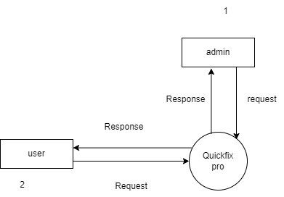
DFD LEVEL 0

Slide 10
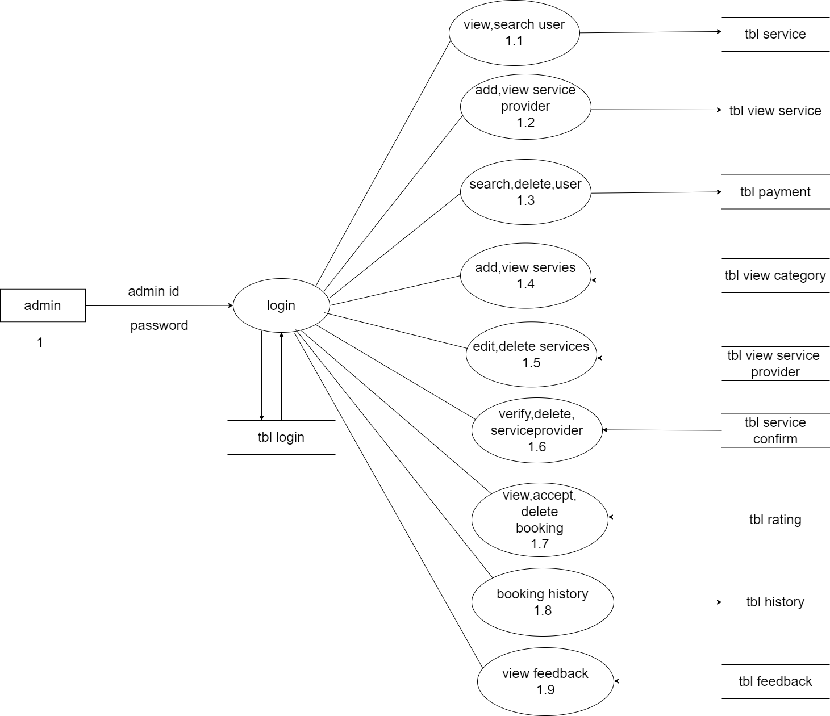
DFD LEVEL 1

Slide 11
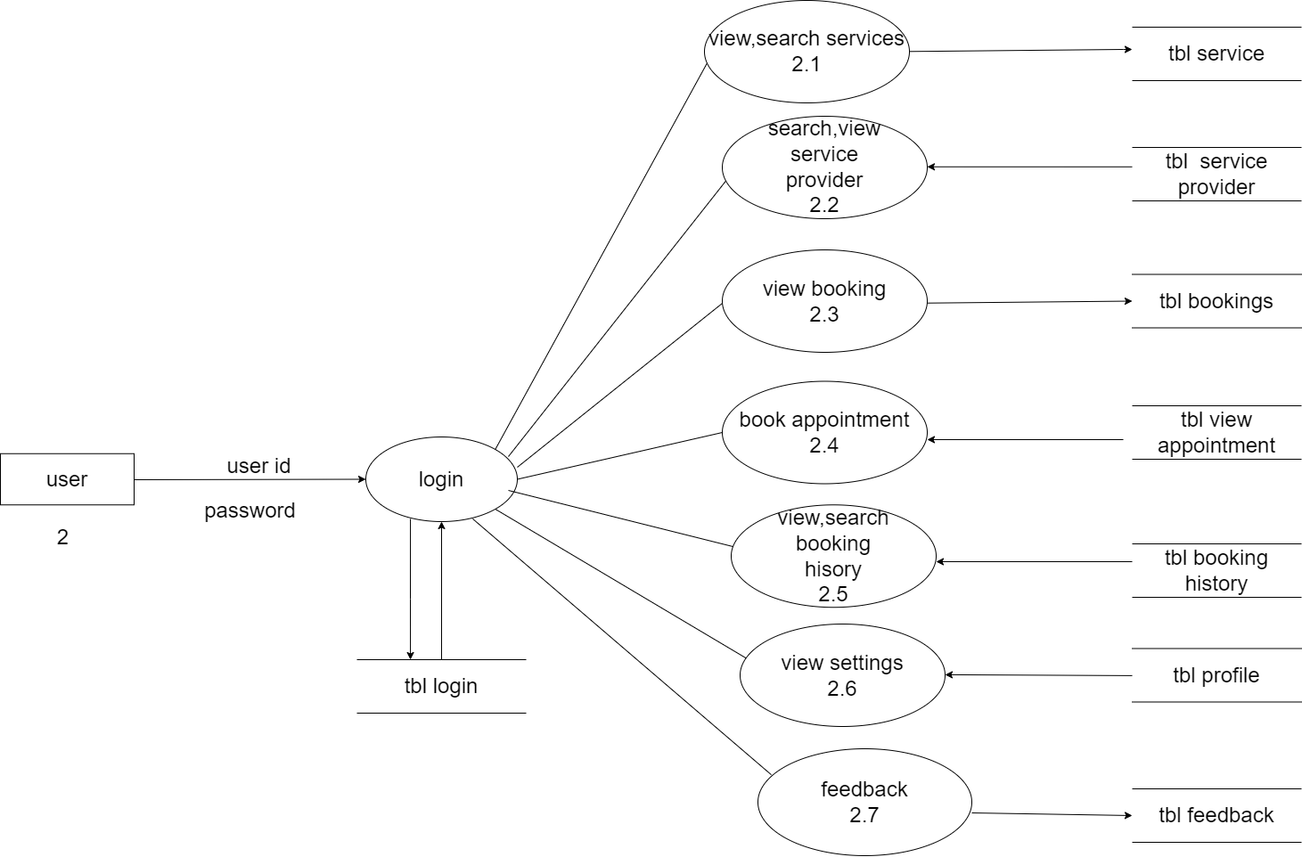
DFD LEVEL 2

Slide 12
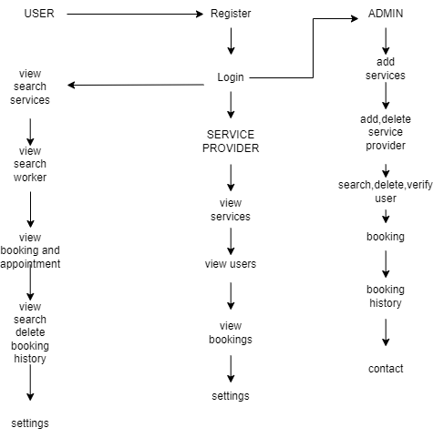
SYSTEM ARCHITECTURE

Slide 13
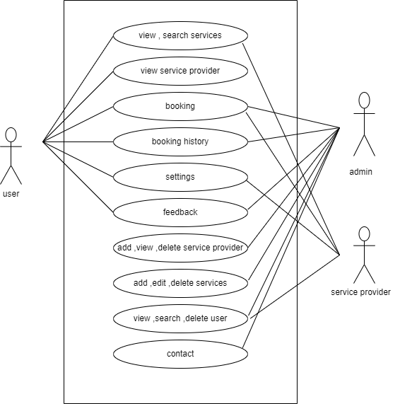
USE CASE DIAGRAM

Slide 14
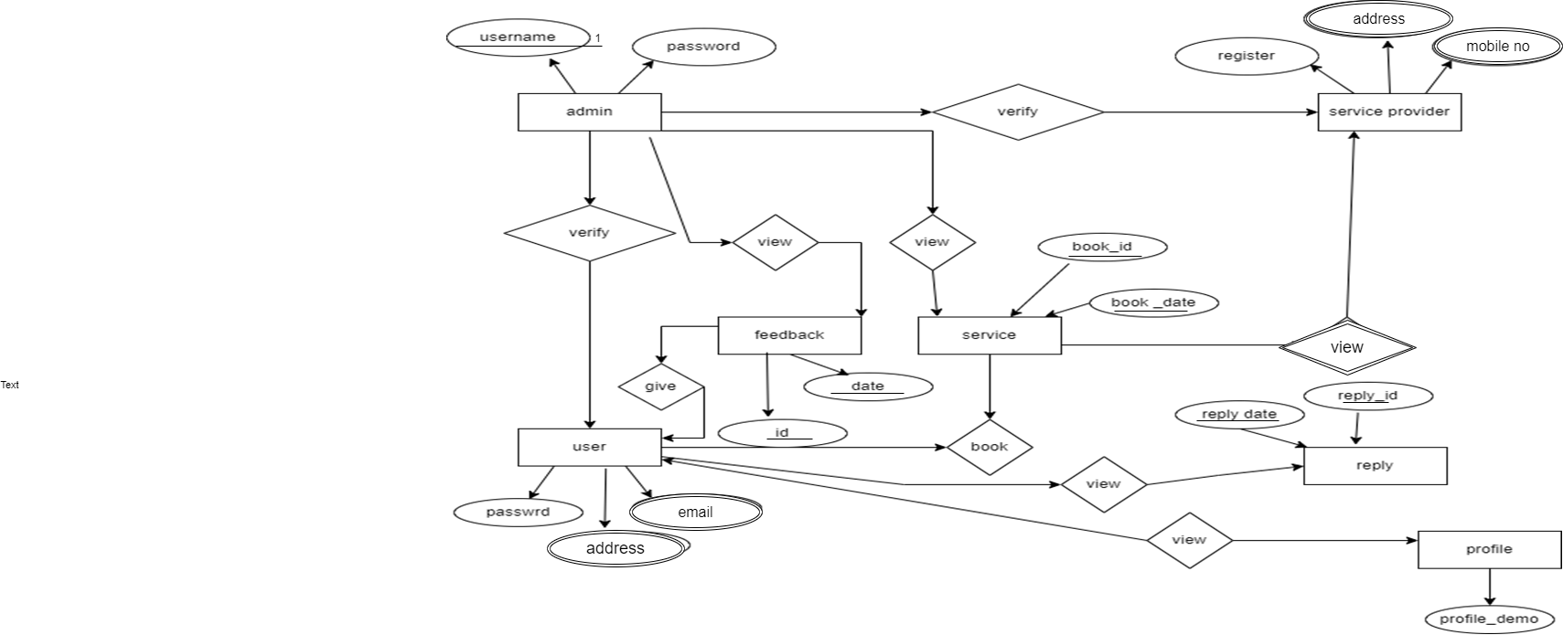
ER DIAGRAM

Slide 15
MODULES
User Registration and Authentication :User registration and login functionality , User profile management.
Subscription model: cost saving option for users
Service Categories : Listing and categorization of services , Detailed descriptions of each service category.
Service Provider : Registration , Profile management ,Verification and validation
Service Booking :Booking services based on user requirements. Scheduling appointments. Real-time availability of service providers.

Slide 16
MODULES (con…)
Payment and Billing :Billing and invoice generation. Payment history and receipts , Integration with payment gateways for online payments.
Location and Map Integration :Geolocation services for users and service providers.
Rating and Review : Users can rate and review service providers. Feedback and ratings displayed on service provider profiles.
Notification : Sending notifications for booking confirmations, updates, and reminders
Admin Panel :User and service provider management , Reporting and analytics , billing and report generation

Slide 17
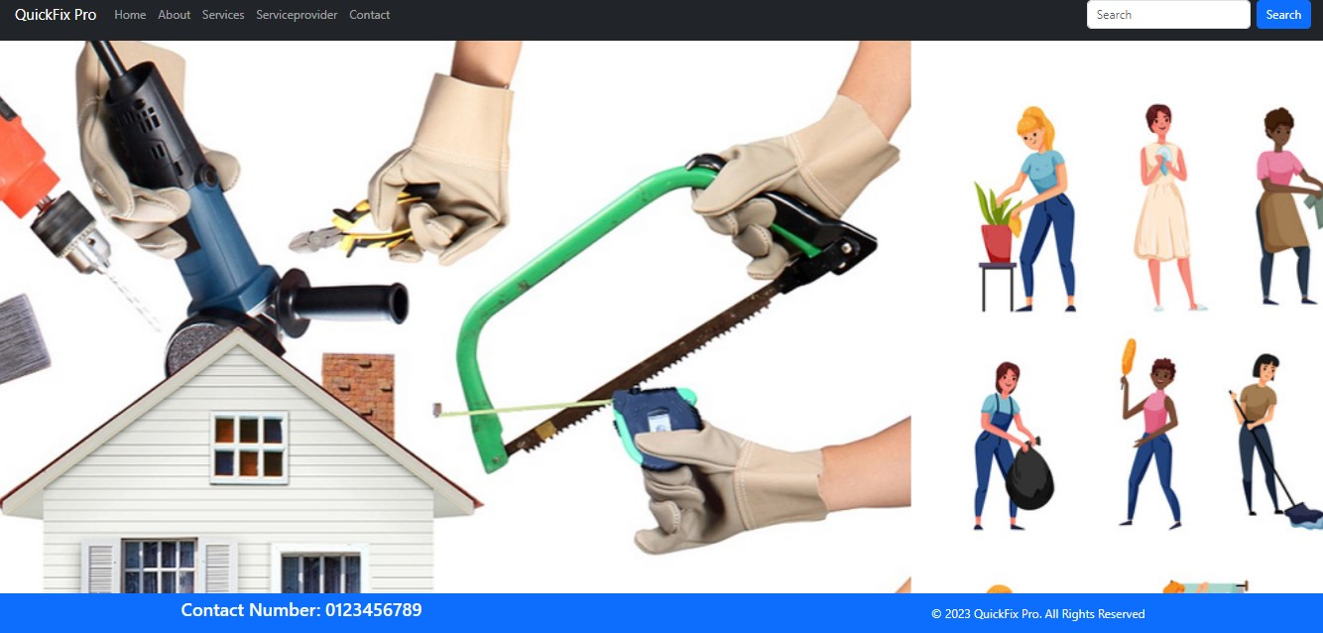
WORK DONE

Slide 18
DATABASE CONNECTION

Slide 19
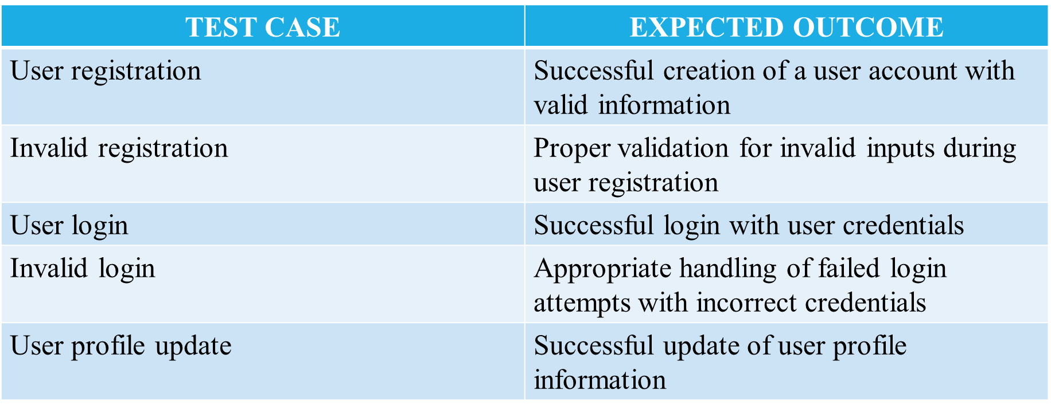
TEST CASES
USER TESTCASE

Slide 20
USER TESTCASE
TEST CASE | EXPECTED OUTCOME
Password change | Successful change of user profile with proper authentication
Authentication test | Access denied for unauthorized user attempting restricted actions
Authorization test | Verification of user access right to ensure proper authorization

Slide 21
SERVICE CATAGORIES TESTCASE
TEST CASE | EXPECTED OUTCOME
Service categories listing | Displays a comprehensive list of service categories on the platform
Category categorization | Properly categories services into distinct categories
Detailed description display | Show description for each service category on the platform
Empty categories | Graceful handling and indication if a service category has no other services
Search functonality | Enable users to efficiently search for specific services within categories

Slide 22
SERVICE CATAGORIES TESTCASE
TEST CASE | EXPECTED OUTCOME
Addition of new service category | Successful addition of new service category with accurate details
Edit service category | Proper modification of service category details without errors
Deletion of service category | Successful removal of a service category without affecting other functinalities

Slide 23
SERVICE PROVIDER TESTCASE
TEST CASE | EXPECTED OUTCOME
Service provider registration | Successful creation of a service provider Account with a valid information
Invalid registration | Proper validation for invalid input during service provider registration
Service provider profile update | Successful update of service provider profile information
Password change | Successful change of service provider password with proper authentication
Verification of service provider | Implementation of a verification process To ensure the legitimacy of service provider

Slide 24
SERVICE PROVIDER TESTCASE
TEST CASE | EXPECTED OUTCOME
Validation of service provider | Validation checks to verify and authenticate service provider information
Deactivation of service provider | Proper deactivation of a service provider account while maintaining data integrity
Reactivation of service provider | Successful reactivation of a previously deactivated service provider

Slide 25
BOOKING TEST CASE
TEST CASE | EXPECTED OUTCOME
Service booking | Sucessful booking of service based on user requirement
Invalid booking | Proper validation for invalid input during the service booking process
Appointment scheduling | Efficent scheduling of appointment for the booked services
Real time availability check | Real time display of service provider availability for selected time slots
Confirmed booking status | Accurate information of booked services with appropriate notification

Slide 26
BOOKING TEST CASE
TEST CASE | EXPECTED OUTCOME
Reschedule appointment | Successful reschedule of appointment with minimal disruption
Booking history | Display of a comprehensive booking history for users to review

Slide 27
FEEDBACK TESTCASE
TEST CASE | EXPECTED OUTCOME
Feedback visibility | Display user feedback prominently on respective service provider profiles
Response to negative reviews | Adequate handiling of negative reviews ,allow service provider to respond
Review deletion | Proper deletion of user reviews if requested or necessary

Slide 28
NOTIFICATION MODULE
TEST CASE | EXPECTED OUTCOME
Booking confirmation notification | Prompt and accurate notification for users upon successful notification
Update notifications | Timely notifications for any updates or changes related to booked services

Slide 29
ADMIN TESTCASE
TEST CASE | EXPECTED OUTCOME
Admin login | Successful login to the admin panel with valid credentials
Invalid admin login | Proper handling of failed admin login attempts with incorrect credentials
Dashboard display | Display of a comprehensive and informative dashboard for admininstrator
User management | Efficient management of user accounts including creation and deactivation
Service provider management | Proper handling of service provider account including verification and deactivation

Slide 30
ADMIN TESTCASE
TEST CASE | EXPECTED OUTCOME
Content management | Successful addition ,modification and removal of services ads and other services
Reporting functinality | Generation of accurate and detailed report for analysis and decision making
Analytics integration | Integration of analytics tools for monitoring and improving system perfomance
Security and access control | Implementation of robust security measures and access control with the admin panel

Slide 31
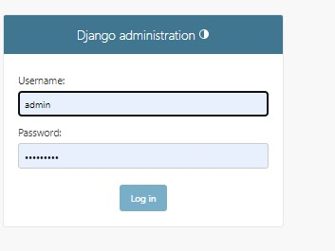

Slide 32
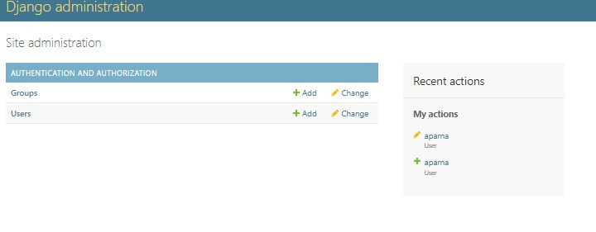

Slide 33
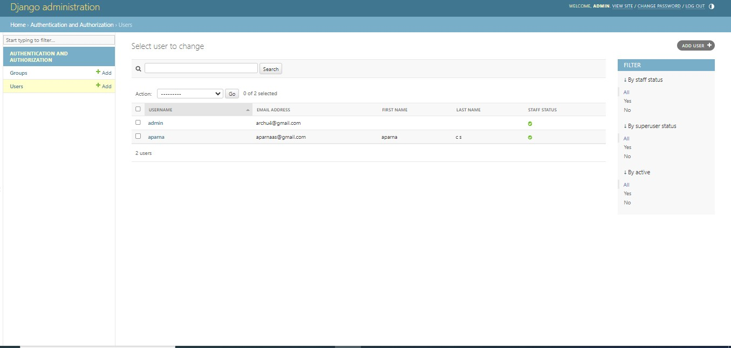

Slide 34
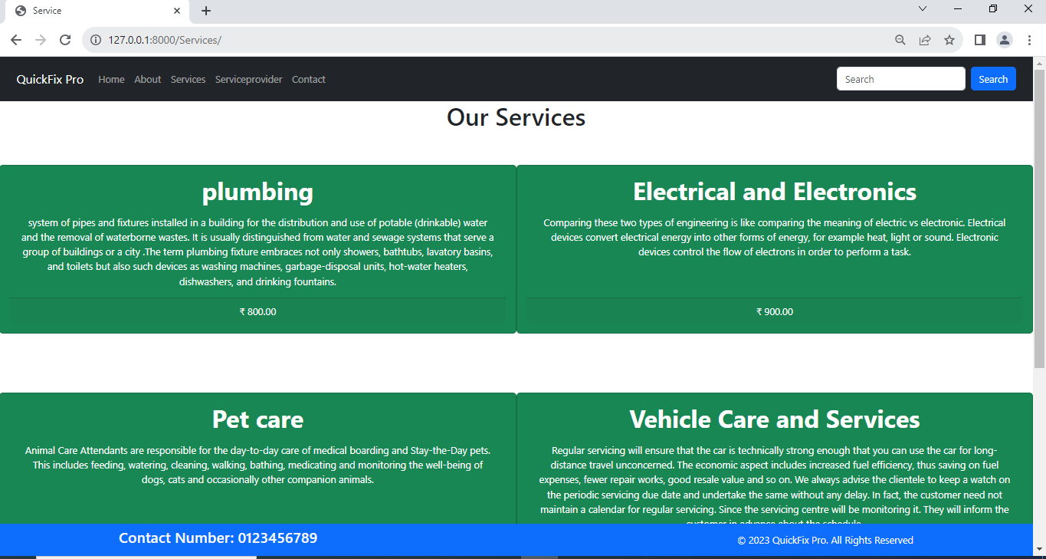

Slide 35
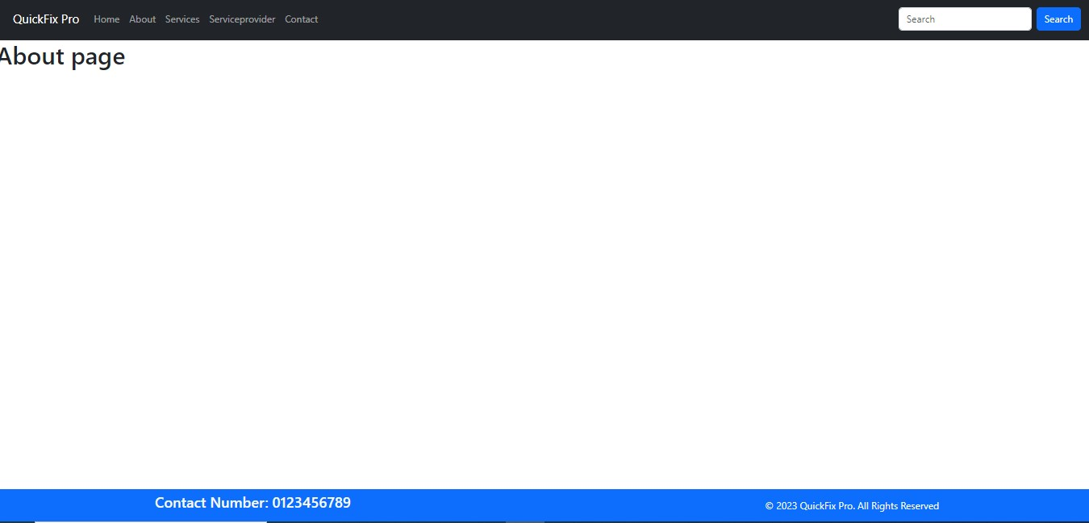

Slide 36
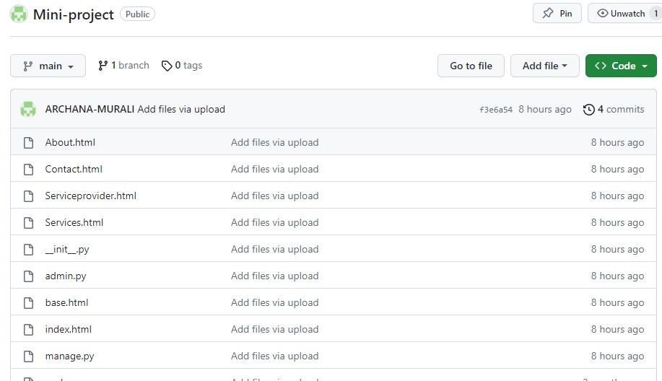
GITHUB HISTORY

Slide 37
FUTURE SCOPE
It involves potential advancements in automation, personalized user experiences, and integration of emerging technologies like AI for efficient task management . Expanding service offerings, enhancing mobile accessibility, and ensuring sustainability practices can contribute to long-term success.

Slide 38
CONCLUSION
The QuickFix Pro website provides a convenient and efficient platform for users to access a variety of essential services from the comfort of their homes.

Slide 39
REFERENCES
Shahrzad Shahriari, Mohammadreza Shahriari , Saeigheiji . “ E-Commerce And It Impactson Global Trend And Market”.
International Journal of Research – Granthaalayah . Vol.3 (Iss.4): April, 2015.
L . RichardYe , Yue Jeff Zhang, Dat-Dao Nguyen , James Chiu ,“Fee-based online services: Exploring Consumers ’willingness to pay ”.
Journal of International Technology and Information Management.
Bo Zhang, Ruihan Yong, Meizi Li, Jianguo Pan , Jifeng Huanglaa , “ A Hybrid Trust Evaluation Framework for E-commerce in Online Social Network: ”. 2169-3536 2016 IEEE.
Translations and content mining are permitted for academic research

Slide 40
THANKYOU

